Slide 1
Database Marketing Project
Team 5
Ahmed Sodeinde (A20187045)
Ahmadreza Homayouni (A20160011)
Subhash Daggubati (A20090700)
Suhao Chen (A20164586)

Slide 2
Introduction of Google Play Dataset
Google Play is a digital distribution service operated and developed by Google Inc. It serves as the official app store for the Android operating system, allowing users to browse and download applications developed with the Android software development kit (SDK) and published through Google. Google Play also serves as a digital media store, offering music, books, movies, and television programs. (Wikipedia)
The store has over 2.6 million apps with a wide array of different applications ranging from kid’s games to language translation apps. These apps are placed in different categories based on minimum age required, intended usage (health and fitness, educational, shopping etc.), cost (free or paid) etc.
Data analysis for these applications will attempt to answer four pertinent questions from the sample dataset with 10,839 Google play apps. The dataset obtained from Kaggle contains the app names, categories, rating scores, reviews, number of installations, genres, size, type, etc.

Slide 3
Overview of our research
Target audience: Android application developers
Research objectives: Explore the relationship of application rating scores with numbers of reviews, numbers of installation, type(free/paid) etc.
Research approach: Use descriptive, inferential statistics & analytical techniques including distributions, frequencies, visualizations, hypothesis tests, etc.

Slide 4
Data dictionary
Name | Label | Type | Values
App | App name | Character | application names
Category | App category | Character | Art and design, education, sports etc.
Rating | App rating score | Numeric | 1.0-5.0
Reviews | Number of app reviews | Numeric | Numbers
Size | Size of an app | Character | Number of m-bytes or varies with device
Installs | Installation category of an app | Character | 0+, 100+, 100M+, etc.
Type | Type of an app | Character | free/paid
Price | Price of an app | Numeric | $0.00 etc.
Content Rating | Content rating of app | Character | Everyone/teen/mature 17+ etc.
Genres | Genres of the app | Character | Art design, auto vehicles, etc.
Last Updated | Date the app last updated | Numeric | 20JUL2018 etc.
Current Version | Current version of the app | Character | 2.2.6.2 etc.
Android Version | Android version need to run the app | Character | 4.1 and up etc.
Installs_Numeric | Numeric of Installs | Numeric | 1000, 500,000 etc.
Installs_Categories_N | Re-categorized Installs | Character | Below 1k, 1k-10k, etc.

Slide 5
Data cleaning
Challenges:
There is one row with completely irrelevant data.
There is one row with Type = NaN
There are more than thousand records in the dataset with Ratings having no value (missing value).
Steps:
Step 1: Deleted the row with irrelevant data.
Step 2: Deleted the row with Type = NaN as deleting single record will not impact us much.
Step 3: As we have more than thousand records with no value for Rating, these rows are imputed with the mean rating of the corresponding app category rather than deleting the rows.

Slide 6
Question 1: Do paid apps have higher rating scores compared to free ones?
In the free apps scatter plot, there appears to be a cluster along the 3.8 to 4.5 rating score indicating a higher rating for $0.00 apps (free apps), which is also evident in the paid apps scatter plot.

Slide 7
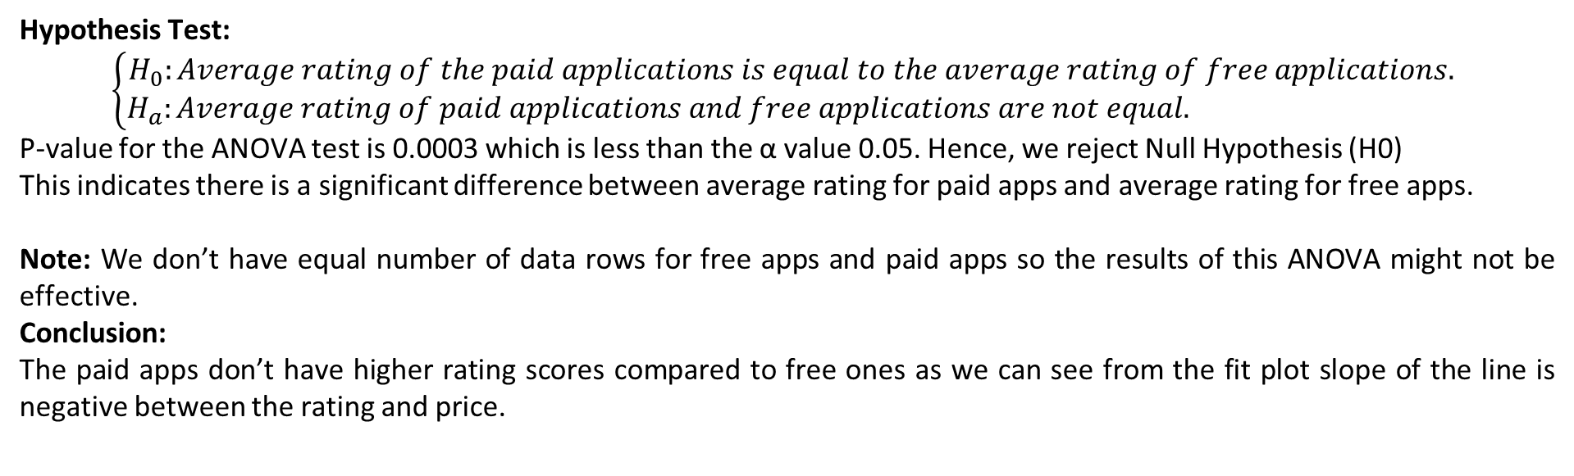
Hypothesis Test:
$$\left\{\begin{aligned}H_{0}:Average rating of the paid applications is equal to the average rating of free applications. \\ H_{a}:Average rating of paid applications and free applications are not equal. \end{aligned}\right.$$
P-value for the ANOVA test is 0.0003 which is less than the α value 0.05. Hence, we reject Null Hypothesis (H0)
This indicates there is a significant difference between average rating for paid apps and average rating for free apps.
Note: We don’t have equal number of data rows for free apps and paid apps so the results of this ANOVA might not be effective.
Conclusion:
The paid apps don’t have higher rating scores compared to free ones as we can see from the fit plot slope of the line is negative between the rating and price.

Slide 8
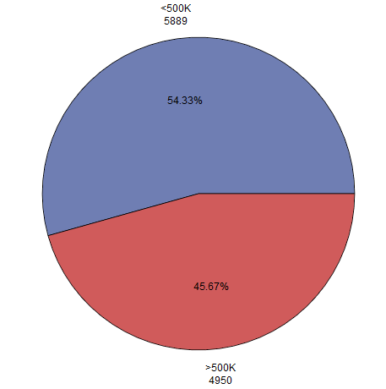
Question 2: Do more than 500K installed applications have higher rating scores compared to less than 500K installed ones?
Installs_Categories_N | Frequency | Percent | Cumulative | Cumulative
 |  |  | Frequency | Percent
Below 1K | 1803 | 16.63 | 1803 | 16.63
1K-10K | 1384 | 12.77 | 3187 | 29.4
10K-50K | 1054 | 9.72 | 4241 | 39.12
50K-100K | 479 | 4.42 | 4720 | 43.54
100K-500K | 1169 | 10.79 | 5889 | 54.33
500K-1M | 539 | 4.97 | 6428 | 59.3
1M-5M | 1637 | 15.1 | 8065 | 74.4
5M-10M | 752 | 6.94 | 8817 | 81.34
10M-50M | 1661 | 15.32 | 10478 | 96.66
Above 50M | 361 | 3.33 | 10839 | 99.99
Original question: Do more than 1M installed applications have higher rating scores compared to less than 1M installed ones?
By examining the frequencies, we find that 500K is a good checkpoint to divide the dataset into two categories with near equal number of records.

Slide 9
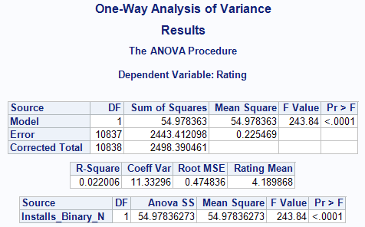
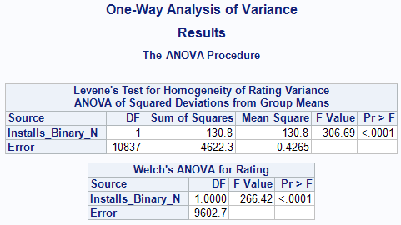
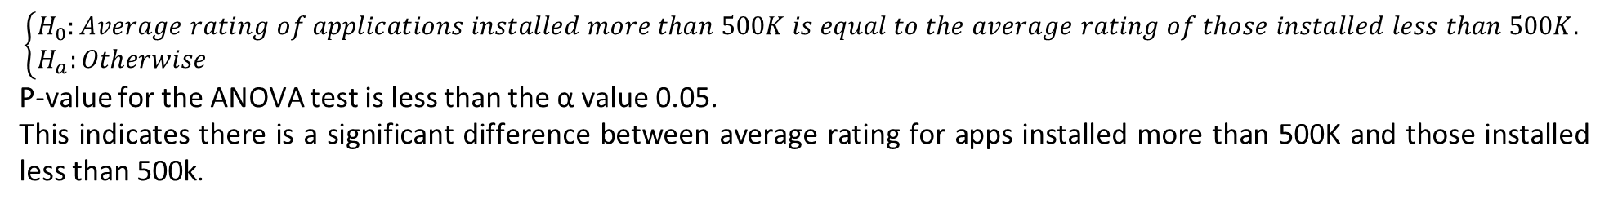
Hypothesis Test:
$$\left\{\begin{aligned}H_{0}:Average rating of applications installed more than 500K is equal to the average rating of those installed less than 500K. \\ H_{a}:Otherwise \end{aligned}\right.$$
P-value for the ANOVA test is less than the α value 0.05.
This indicates there is a significant difference between average rating for apps installed more than 500K and those installed less than 500k.

Slide 10
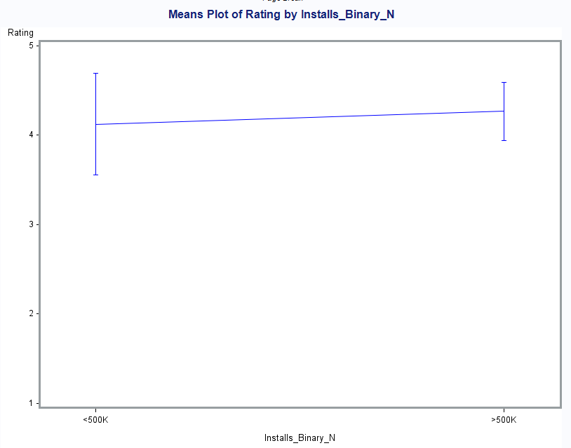
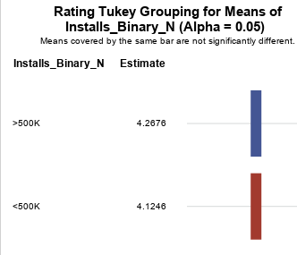
Conclusion: From the two above plots, we can see that applications installed more than 500K have a higher average rating score.

Slide 11
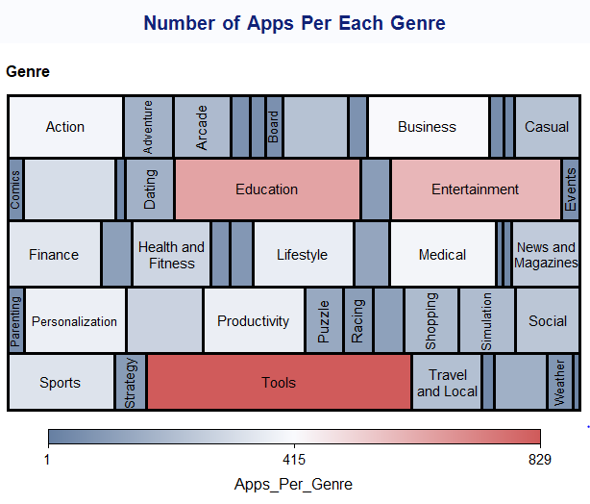
Question 3: In each genre, which three applications are the most popular ones?
There are 50 individual genres. Each application has been assigned with one or more genres.
Here we are considering each combination of the genres as one category and top three popular applications are being filtered.
Popularity: We are defining popular app as the app with higher installations. In case of equal number of installations, we are considering the app with highest rating as the more popular application.

Slide 12
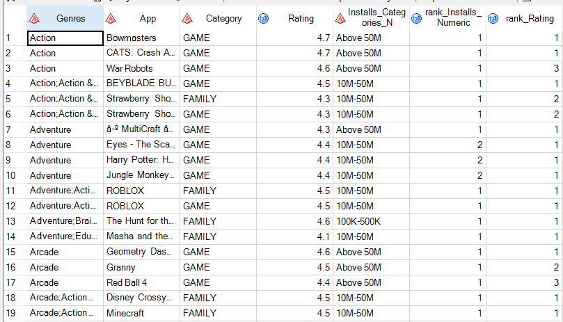
Steps:
Step 1: Run Rank task to rank Installs_Numeric Column by Genres column.
Ranking Method:
Rank largest to lowest
If set of Ranking column values are equal then assign the smallest rank.
Step 2: Run Rank task to rank Ratings column by Genres and rank_Installs_Numeric columns.
Ranking Method:
Same as in step 1.
Step 3: Apply Filter Task to filter the apps with both rank_Installs_Numeric and rank_Ratings columns in (1, 2, 3)
Step 4: Order the list by Genres, Rank_Installations_Numeric and Rank_Ratings.
Step 5: Use PROC SQL statement to pick top 3 rows of each genre and find union of them.
Adjacent figure shows some of the results.

Slide 13
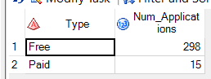
Among the popular applications of each genres combination we can see that 298 are Free applications and 15 are Paid applications.
Conclusion:
Free applications are more in number among the popular application of each of the genres.

Slide 14
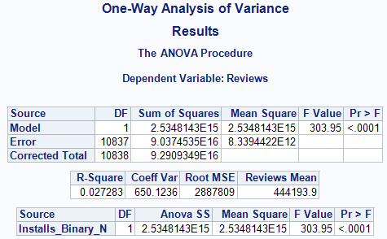
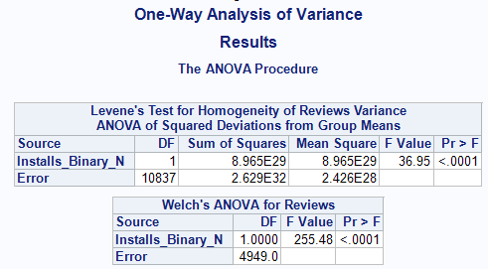
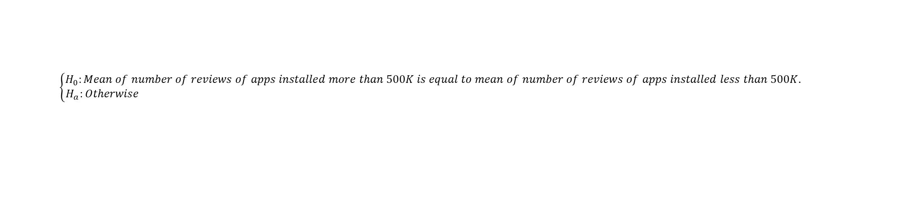
Question 4: Is there any relation between the number of installations and reviews?
Hypothesis Test:
$$\left\{\begin{aligned}H_{0}:Mean of number of reviews of apps installed more than 500K is equal to mean of number of reviews of apps installed less than 500K. \\ H_{a}:Otherwise \end{aligned}\right.$$
P-value for the ANOVA test is less than the α value 0.05.

Slide 15
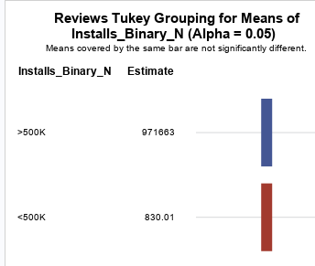
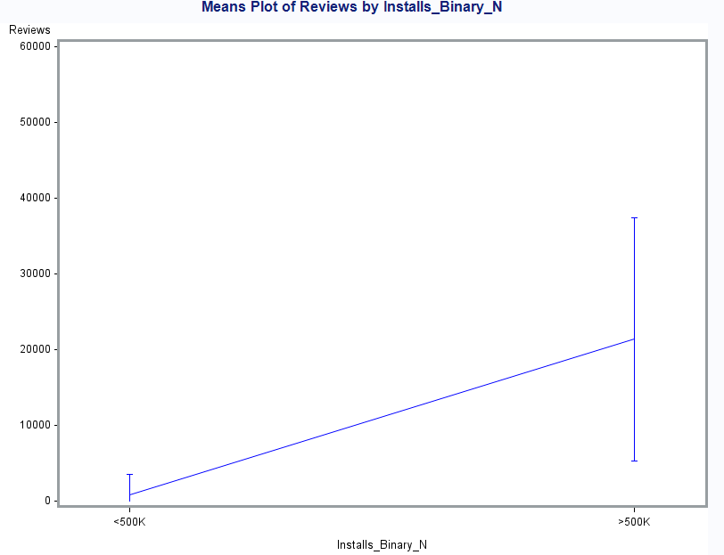
This indicates there is a significant difference between mean of number of reviews of apps installed more than 500𝐾 and mean of number of reviews of apps installed less than 500𝐾 .
Conclusion: More installed applications have much more average reviews.

